Slide 1
Object Detection

Slide 2
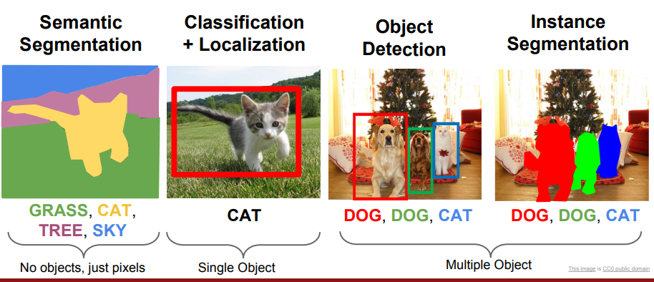
Computer vision tasks
http://cs231n.stanford.edu/slides/2017/cs231n_2017_lecture11.pdf

Slide 3
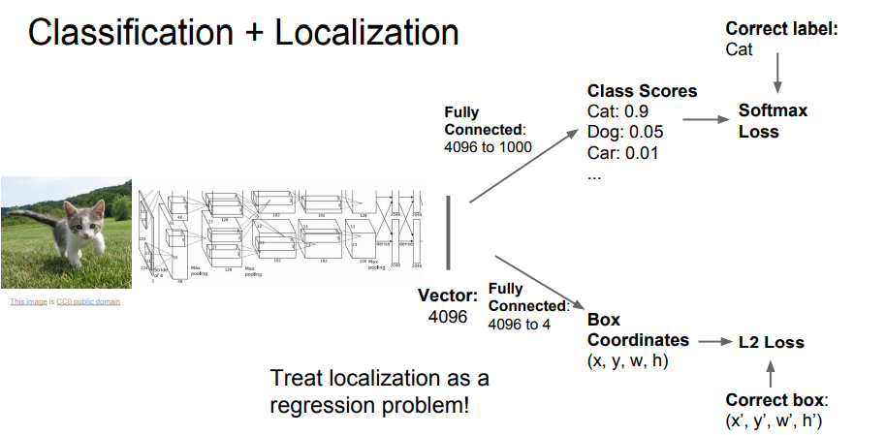
Classification + Localization

Slide 4
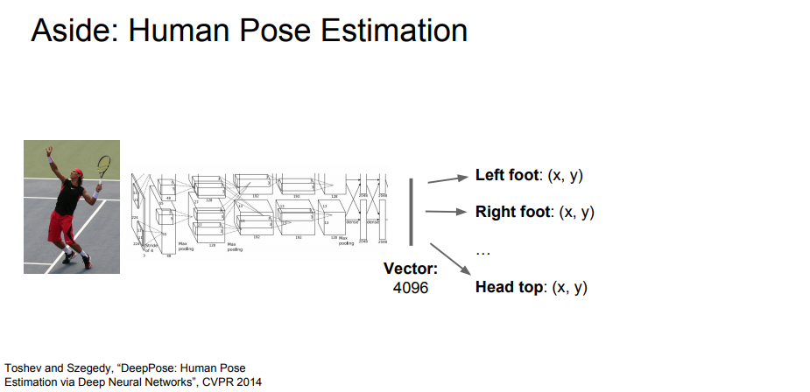
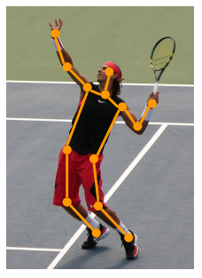
Aside: Human Pose Estimation

Slide 5
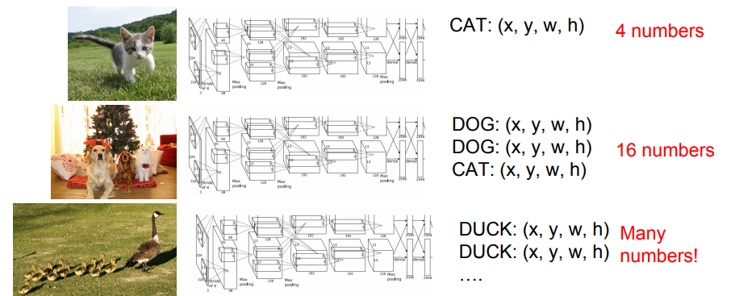
Object detection

Slide 6
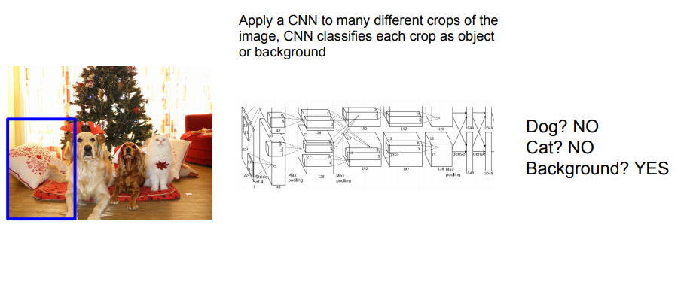
Object Detection as Classification: Sliding Window

Slide 7
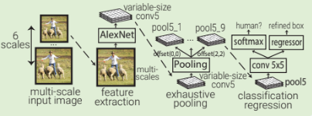
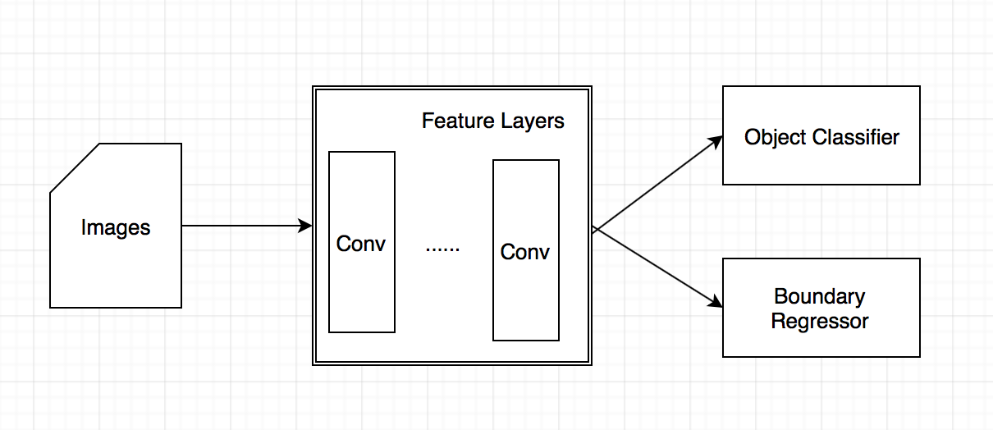
Overfeat (2013)
the first published neural net based object localization architecutre
Sliding window approach
Applies classification at multiple evenly spaced square windows over multiple scale of the image.
Due to extensive pooling, windows do not align too well aligned with the objects.
Based on AlexNet

Slide 8
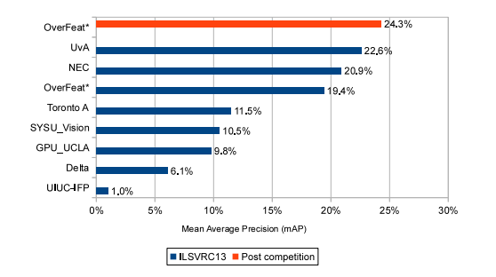
ImageNet 2013 Detection results

Slide 9
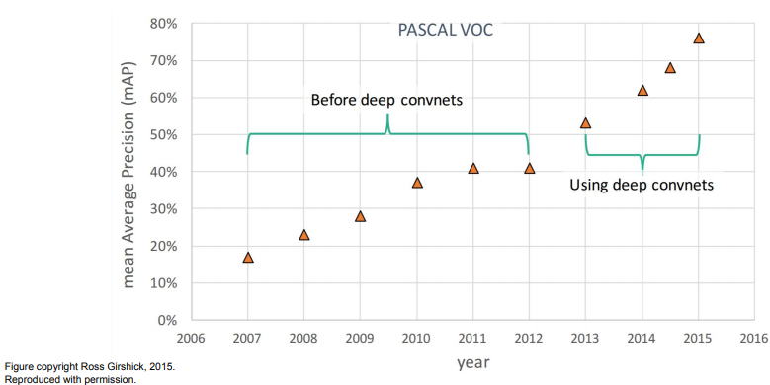
Object Detection: Impact of Deep Learning

Slide 10
Problems with sliding window
How to choose crop: size, position aspect ratio.
Brute force … very computationally expensive

Slide 11
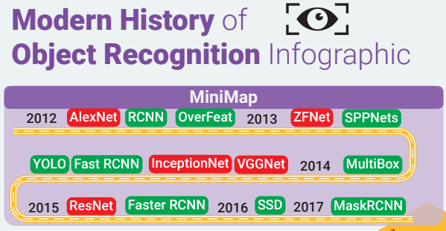
https://medium.com/@nikasa1889/the-modern-history-of-object-recognition-infographic-aea18517c318

Slide 12



Object Detection datasets and challenges
PASCAL VOC

Slide 13
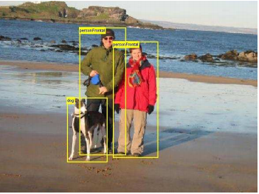
PASCAL VOC
The PASCAL VOC dataset (2012) is well-known an commonly used for object detection and segmentation.
More than 11k images compose the train and validation datasets while 10k images are dedicated to the test dataset.
Metric: Intersection over Union (IoU)

Slide 14
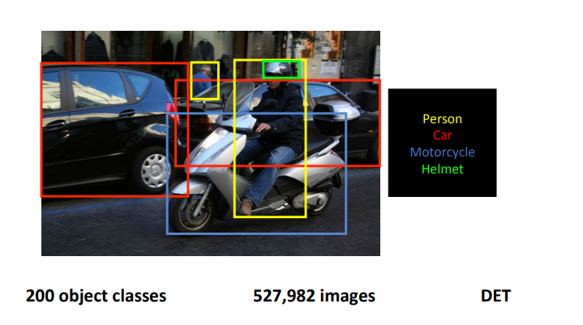
The ILSVRC competition has its own image dataset that is a subset of the ImageNet dataset.
1,000 object categories spread over ~1.2 million images.
Half of these images also have bounding boxes around the class category object
Evaluation based after PASCAL VOC:
Algorithm outputs a list of bounding box detections with confidences
A detection is considered correct if intersection over union (IoU) overlap with ground truth > threshold (0.5)
Evaluated by average precision per object class
Winners of challenge is the team that wins the most object categories
http://image-net.org/challenges/talks/2016/ECCV2016_ilsvrc_coco_detection_segmentation.pdf

Slide 15
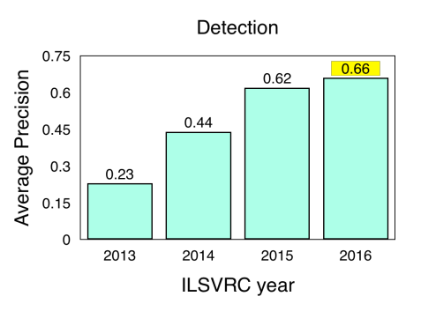

Slide 16
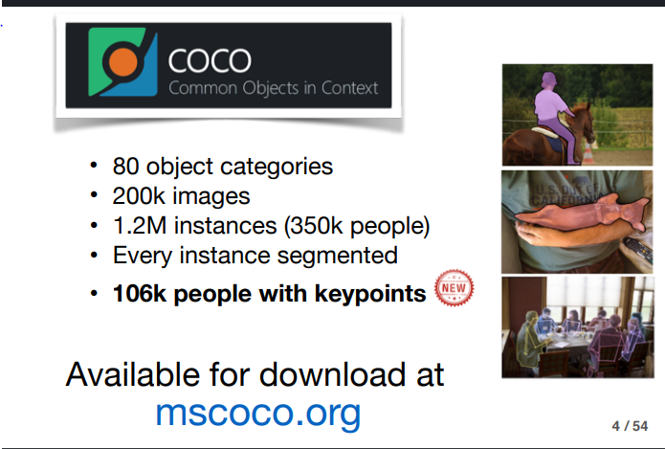

Slide 17
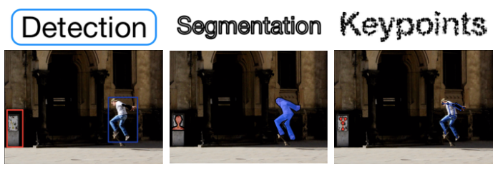
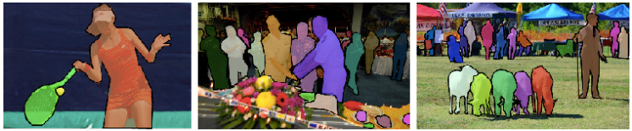

Slide 18
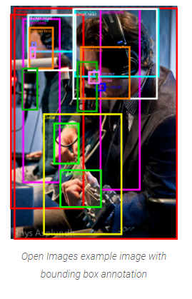
Open Images Dataset
first released in 2016
complex scenes that span thousands of classes of objects
~15.4 million bounding boxes of 600 classes of objects

